Slide 1

Flow-based Generative Model
Hung-yi Lee
李宏毅
Notes:
Good ref:
https://lilianweng.github.io/lil-log/2018/10/13/flow-based-deep-generative-models.html
https://blog.evjang.com/2018/01/nf1.html
https://blog.evjang.com/2018/01/nf2.html
YT:https://www.youtube.com/watch?v=grsO57XMJMk
Chinese version:
https://zhuanlan.zhihu.com/p/43157737
https://www.kexue.fm/archives/5776
https://zhuanlan.zhihu.com/p/39676312
https://openai.com/blog/glow/ (open ai’s blog, also review)
http://ml4a.github.io/classes/itp-F18/09/ (demo with face ) -> openai’s demo
https://www.slideshare.net/DeepLearningJP2016/dlalphastar?next_slideshow=1 (完整 但 日文)
Reference:
[1] ICLR 2015 NICE- Non-linear Independent Components Estimation
[2] ICLR 2017 Density estimation using Real NVP
[3] 2018 Glow: Generative Flow with Invertible 1×1 Convolutions
Video:
https://www.youtube.com/watch?v=_ALdCSSVYkw
https://www.youtube.com/watch?v=Xrx_neqptFI

Slide 2
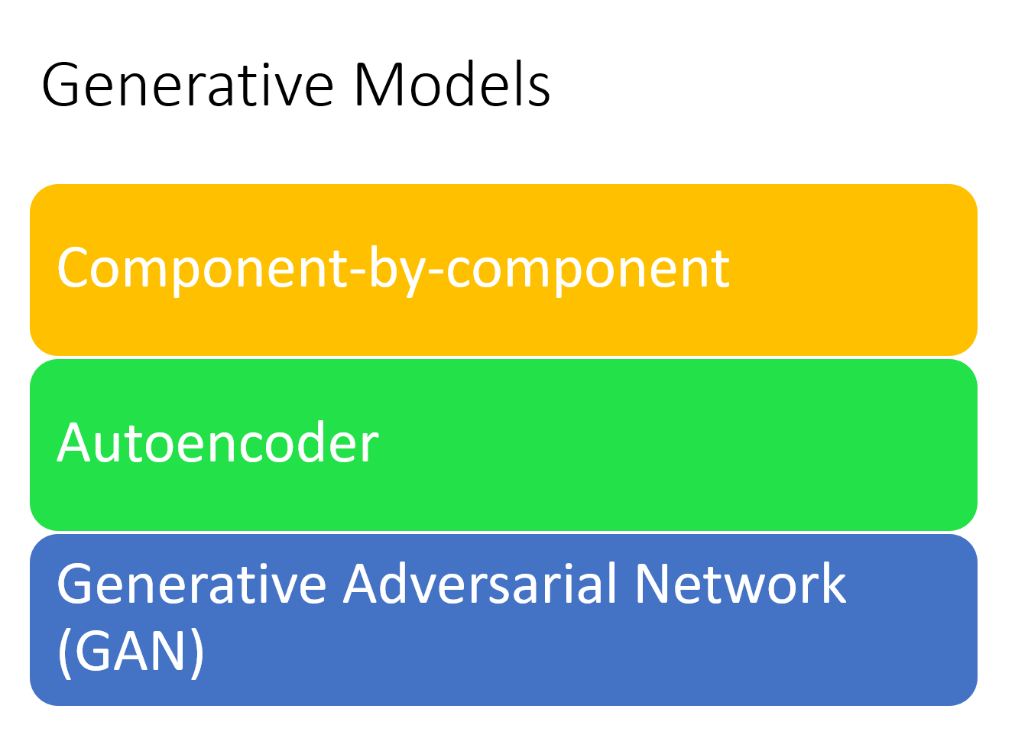
Autoregressive model
Link: https://youtu.be/YNUek8ioAJk
Link: https://youtu.be/8zomhgKrsmQ

Slide 3
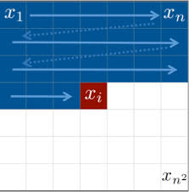
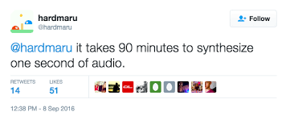
Generative Models
Component-by-component (Auto-regressive Model)
What is the best order for the components?
Slow generation
Variational Auto-encoder
Optimizing a lower bound
Generative Adversarial Network
Unstable training

Slide 4
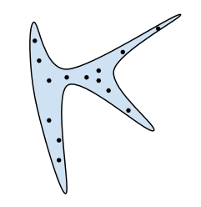



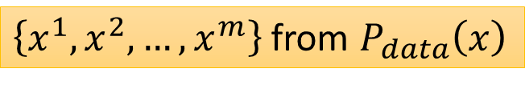

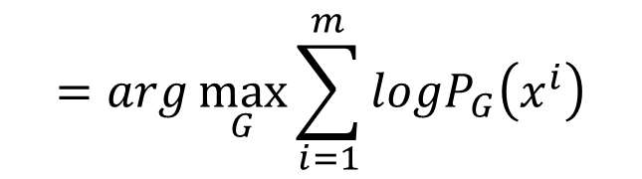






Generator
A generator G is a network. The network defines a probability distribution $p_{G}$
$$p_{G}\text{(}\text{x}\text{)}$$
$$p_{data}\left(x\right)$$
Normal Distribution
generator
G
$$z$$
$$x=G\left(z\right)$$
$$π\text{(}\text{z}\text{)}$$
as close as possible
$$=arg\max_{G}{\sum_{i=1}^{m}{logP_{G}\left(x^{i}\right)}}$$
$$G^{∗}$$
$\left\{x^{1},x^{2},…,x^{m}\right\}$ from $P_{data}\left(x\right)$
$$≈arg\min_{G}{KL\left(P_{data}||P_{G}\right) }$$
Ref: https://youtu.be/DMA4MrNieWo
Notes:
$$p_{G}\left(x\right)=\int_{z}{π\left(z\right)I_{\left[G\left(z\right)=x\right]}dz}$$

Slide 5
Generator
A generator G is a network. The network defines a probability distribution $p_{G}$
$$p_{G}\text{(}\text{x}\text{)}$$
$$p_{data}\left(x\right)$$
Normal Distribution
generator
G
$$z$$
$$x=G\left(z\right)$$
$$π\text{(}\text{z}\text{)}$$
as close as possible
$$=arg\max_{G}{\sum_{i=1}^{m}{logP_{G}\left(x^{i}\right)}}$$
$$G^{∗}$$
$\left\{x^{1},x^{2},…,x^{m}\right\}$ from $P_{data}\left(x\right)$
Flow-based model directly optimizes the objective function.
Notes:
$$p_{G}\left(x\right)=\int_{z}{π\left(z\right)I_{\left[G\left(z\right)=x\right]}dz}$$

Slide 6
Math Background
Jacobian, Determinant, Change of Variable Theorem
Notes:
https://openai.com/blog/glow/ (open ai’s blog, also review)
http://ml4a.github.io/classes/itp-F18/09/ (demo with face ) -> openai’s demo
https://www.slideshare.net/DeepLearningJP2016/dlalphastar?next_slideshow=1 (完整 但 日文)
Reference:
[1] ICLR 2015 NICE- Non-linear Independent Components Estimation
[2] ICLR 2017 Density estimation using Real NVP
[3] 2018 Glow: Generative Flow with Invertible 1×1 Convolutions
Video:
https://www.youtube.com/watch?v=_ALdCSSVYkw
https://www.youtube.com/watch?v=Xrx_neqptFI

Slide 7

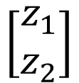

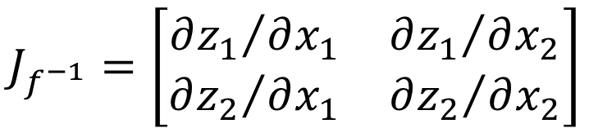
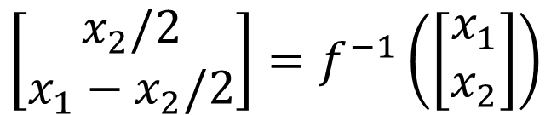
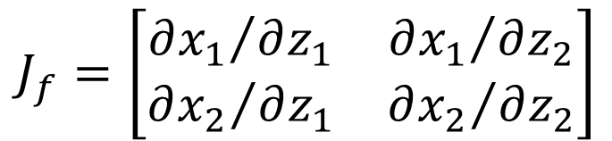
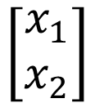
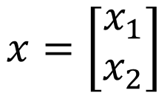

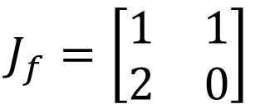
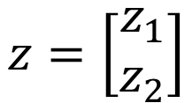
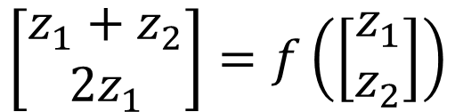
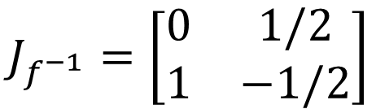
Jacobian Matrix
$$\left[\begin{aligned}x_{1} \\ x_{2}\end{aligned}\right]$$
$$\left[\begin{aligned}z_{1}+z_{2} \\ 2z_{1}\end{aligned}\right]=f\left(\left[\begin{aligned}z_{1} \\ z_{2}\end{aligned}\right]\right)$$
$$z=\left[\begin{aligned}z_{1} \\ z_{2}\end{aligned}\right]$$
$$x=\left[\begin{aligned}x_{1} \\ x_{2}\end{aligned}\right]$$
$$\left[\begin{aligned}z_{1} \\ z_{2}\end{aligned}\right]$$
$$\left[\begin{aligned}x_{2}/2 \\ x_{1}−x_{2}/2\end{aligned}\right]=f^{−1}\left(\left[\begin{aligned}x_{1} \\ x_{2}\end{aligned}\right]\right)$$
$$x=f\left(z\right)$$
$$z=f^{−1}\left(x\right)$$
input
$$J_{f}=\left[\begin{matrix}{∂x_{1}}/{∂z_{1}} & {∂x_{1}}/{∂z_{2}} \\ {∂x_{2}}/{∂z_{1}} & {∂x_{2}}/{∂z_{2}}\end{matrix}\right]$$
$$J_{f}=\left[\begin{matrix}1 & 1 \\ 2 & 0\end{matrix}\right]$$
output
$$J_{f^{−1}}=\left[\begin{matrix}0 & 1/2 \\ 1 & −1/2\end{matrix}\right]$$
$$J_{f^{−1}}=\left[\begin{matrix}{∂z_{1}}/{∂x_{1}} & {∂z_{1}}/{∂x_{2}} \\ {∂z_{2}}/{∂x_{1}} & {∂z_{2}}/{∂x_{2}}\end{matrix}\right]$$
$$J_{f}J_{f^{−1}}=I$$

Slide 8






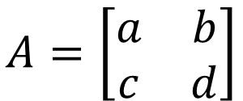







Determinant
The determinant of a square matrix is a scalar that provides information about the matrix.
2 X 2
3 x 3
$$A=\left[\begin{matrix}a_{1} & a_{2} & a_{3} \\ a_{4} & a_{5} & a_{6} \\ a_{7} & a_{8} & a_{9}\end{matrix}\right]$$
$$A=\left[\begin{matrix}a & b \\ c & d\end{matrix}\right]$$
$$det\left(A\right)=$$
$$ad$$
$$−bc$$
$$det\left(A\right)=$$
$$a_{1}a_{5}a_{9}$$
$$+a_{2}a_{6}a_{7}$$
$$+a_{3}a_{4}a_{8}$$
$$det\left(A\right)=1/{det\left(A^{−1}\right)}$$
$$−a_{3}a_{5}a_{7}$$
$$−a_{2}a_{4}a_{9}$$
$$−a_{1}a_{6}a_{8}$$
$$det\left(J_{f}\right)=1/{det\left(J_{f^{−1}}\right)}$$

Slide 9
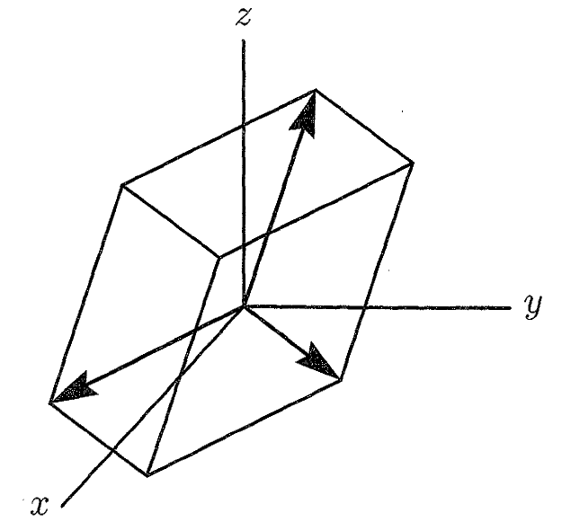

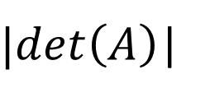




Determinant
2 X 2
$$A=\left[\begin{matrix}a_{1} & a_{2} & a_{3} \\ a_{4} & a_{5} & a_{6} \\ a_{7} & a_{8} & a_{9}\end{matrix}\right]$$
3 x 3
$$A=\left[\begin{matrix}a & b \\ c & d\end{matrix}\right]$$
$$\left(a_{7},a_{8},a_{9}\right)$$
$|det\left(A\right)$|
絕對值!
(c,d)
V
(a,b)
$$\left(a_{1},a_{2},a_{3}\right)$$
$$\left(a_{4},a_{5},a_{6}\right)$$
Notes:
det(A) = volumn of box
How about A=I
How about A=Q (orthogonal matrix)
Draw a figure

Slide 10










Change of Variable Theorem
$$π\left(z^{′}\right)$$
$$π\left(z\right)$$
$$z$$
What are their relations?
$$z^{′}$$
$$x=f\left(z\right)$$
$$f$$
$$p\left(x^{′}\right)$$
$$p\left(x\right)$$
$$x$$
$$x^{′}$$

Slide 11



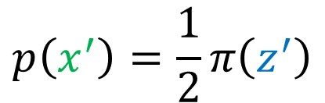

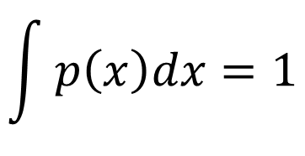

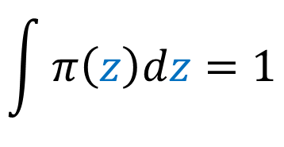



Change of Variable Theorem
$$\int{π\left(z\right)dz=1}$$
$$π\left(z\right)$$
1
$$z$$
0
$$z^{′}$$
1
$$x=f\left(z\right)$$
$$p\left(x^{′}\right)=\frac{1}{2}π\left(z^{′}\right)$$
$$=2z+1$$
$$\int{p\left(x\right)dx=1}$$
$$p\left(x\right)$$
0.5
$$x$$
1
$$x^{′}$$
3

Slide 12



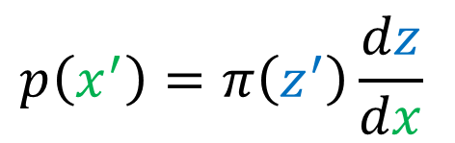


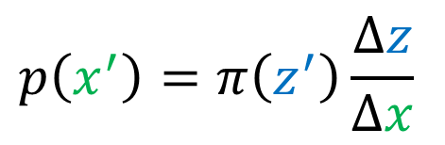




Change of Variable Theorem
藍色方塊和綠色方塊需要有相同的面積
$$π\left(z^{′}\right)$$
$$z$$
$$z^{′}$$
$$z^{′}+∆z$$
$$p\left(x^{′}\right)∆x=π\left(z^{′}\right)∆z$$
$$p\left(x^{′} \right)$$
$$p\left(x^{′}\right)=π\left(z^{′}\right)\frac{∆z}{∆x}$$
$$x$$
$$x^{′}$$
$$x^{′}+∆x$$
$$p\left(x^{′}\right)=π\left(z^{′}\right)\frac{dz}{dx}$$
要加絕對值

Slide 13





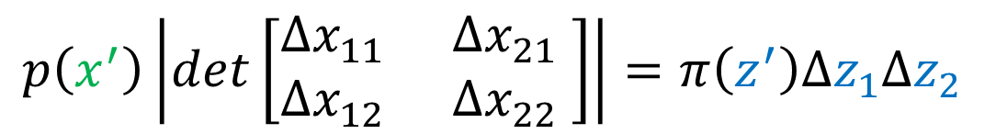







Change of Variable Theorem
$$z_{2}$$
$$x_{2}$$
$$∆x_{12}$$
$$∆z_{2}$$
$$∆x_{22}$$
$$π\left(z^{′}\right)$$
$$p\left(x^{′}\right)$$
$$∆z_{1}$$
$$∆x_{21}$$
$$z_{1}$$
$$∆x_{11}$$
$$x_{1}$$
$$p\left(x^{′}\right)\left|det\left[\begin{matrix}∆x_{11} & ∆x_{21} \\ ∆x_{12} & ∆x_{22} \end{matrix}\right]\right|=π\left(z^{′}\right)∆z_{1}∆z_{2}$$

Slide 14
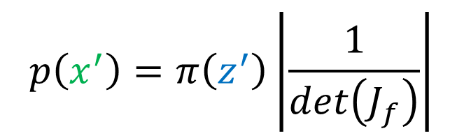
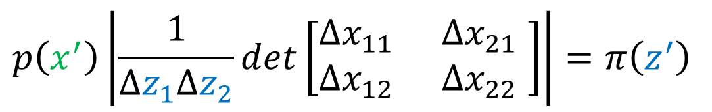

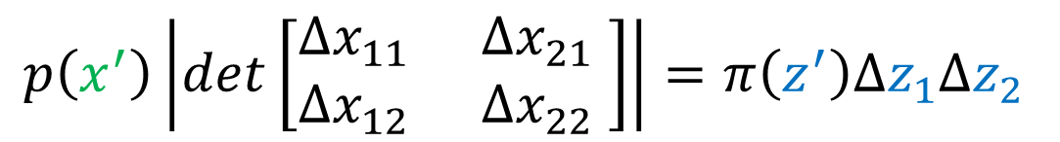
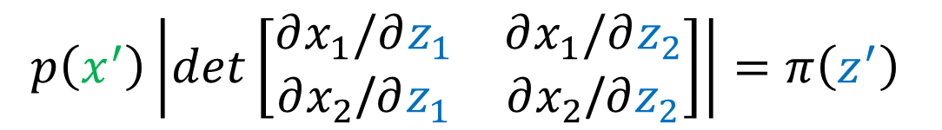
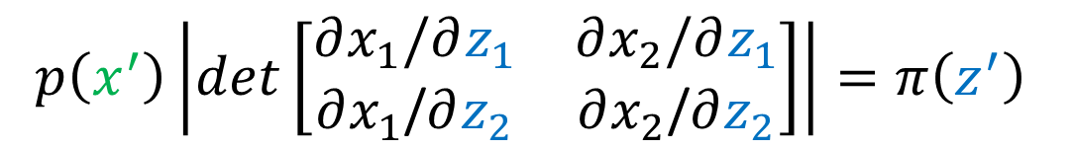

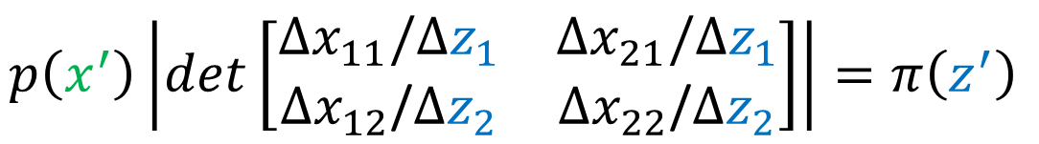
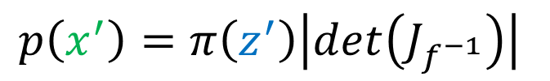
$$p\left(x^{′}\right)\left|det\left[\begin{matrix}∆x_{11} & ∆x_{21} \\ ∆x_{12} & ∆x_{22} \end{matrix}\right]\right|=π\left(z^{′}\right)∆z_{1}∆z_{2}$$
$$x=f\left(z\right)$$
$$p\left(x^{′}\right)\left|\frac{1}{∆z_{1}∆z_{2}}det\left[\begin{matrix}∆x_{11} & ∆x_{21} \\ ∆x_{12} & ∆x_{22} \end{matrix}\right]\right|=π\left(z^{′}\right)$$
$$p\left(x^{′}\right)\left|det\left[\begin{matrix}∆x_{11}\text{/}∆z_{1} & ∆x_{21}\text{/}∆z_{1} \\ ∆x_{12}\text{/}∆z_{2} & ∆x_{22}\text{/}∆z_{2}\end{matrix}\right]\right|=π\left(z^{′}\right)$$
$$p\left(x^{′}\right)\left|det\left[\begin{matrix}∂x_{1}\text{/}∂z_{1} & ∂x_{2}\text{/}∂z_{1} \\ ∂x_{1}\text{/}∂z_{2} & ∂x_{2}\text{/}∂z_{2}\end{matrix}\right]\right|=π\left(z^{′}\right)$$
$$p\left(x^{′}\right)\left|det\left[\begin{matrix}∂x_{1}\text{/}∂z_{1} & ∂x_{1}\text{/}∂z_{2} \\ ∂x_{2}\text{/}∂z_{1} & ∂x_{2}\text{/}∂z_{2}\end{matrix}\right]\right|=π\left(z^{′}\right)$$
$$p\left(x^{′}\right)=π\left(z^{′}\right)\left|\frac{1}{det\left(J_{f}\right)}\right|$$
$$p\left(x^{′}\right)\left|det\left(J_{f}\right)\right|=π\left(z^{′}\right)$$
$$p\left(x^{′}\right)=π\left(z^{′}\right)\left|det\left(J_{f^{−1}}\right)\right|$$

Slide 15
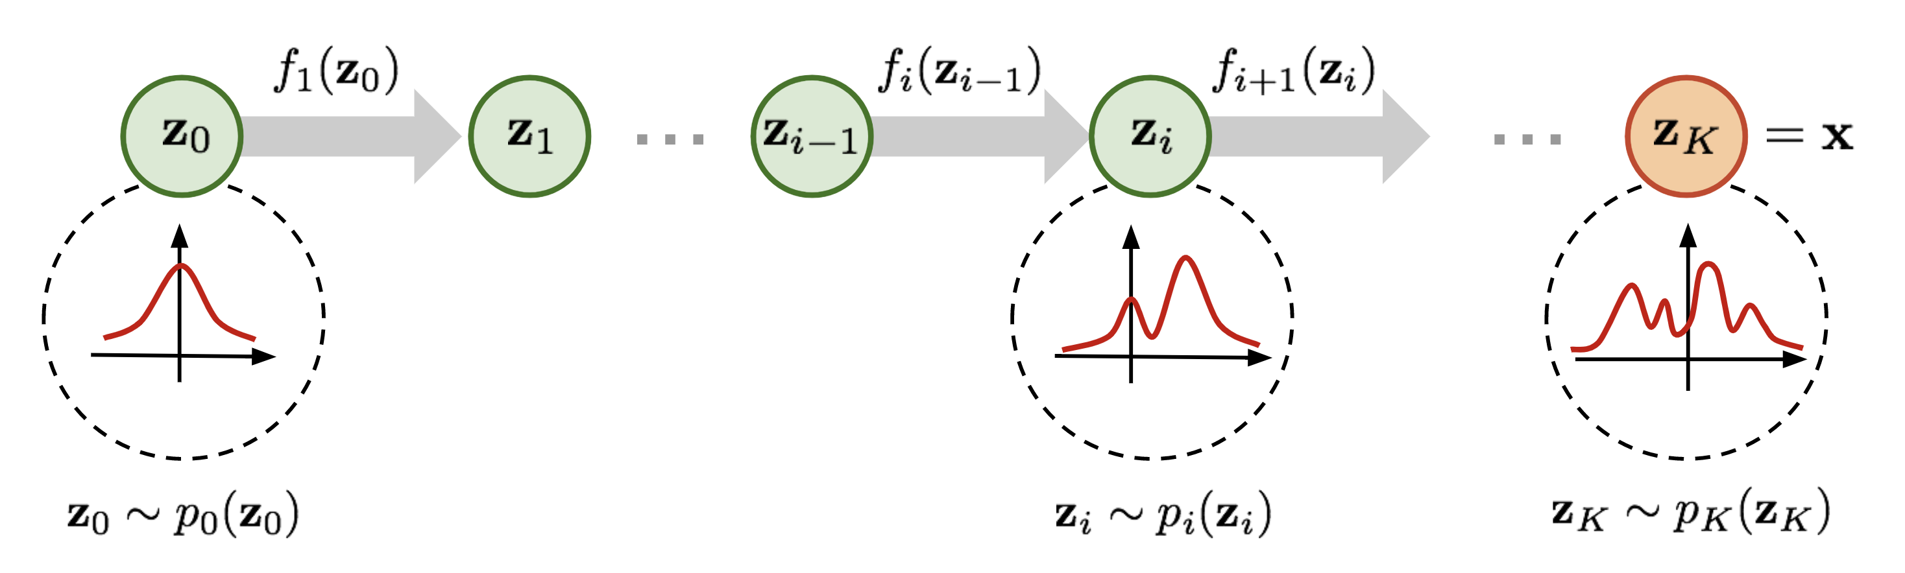
Formal Explanation
Notes:
https://openai.com/blog/glow/ (open ai’s blog, also review)
http://ml4a.github.io/classes/itp-F18/09/ (demo with face ) -> openai’s demo
https://www.slideshare.net/DeepLearningJP2016/dlalphastar?next_slideshow=1 (完整 但 日文)
Reference:
[1] ICLR 2015 NICE- Non-linear Independent Components Estimation
[2] ICLR 2017 Density estimation using Real NVP
[3] 2018 Glow: Generative Flow with Invertible 1×1 Convolutions
Video:
https://www.youtube.com/watch?v=_ALdCSSVYkw
https://www.youtube.com/watch?v=Xrx_neqptFI

Slide 16




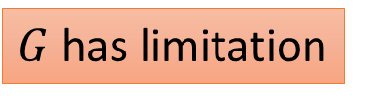


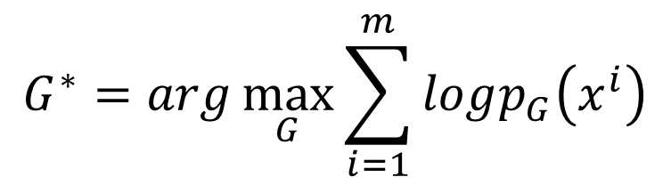
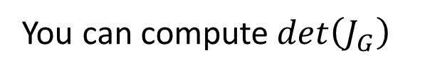
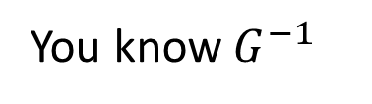


Flow-based Model
$$p\left(x^{′}\right)\left|det\left(J_{f}\right)\right|=π\left(z^{′}\right)$$
$$p\left(x^{′}\right)=π\left(z^{′}\right)\left|det\left(J_{f^{−1}}\right)\right|$$
Normal Distribution
$$p_{G}\text{(}\text{x}\text{)}$$
generator
G
$$π\text{(}\text{z}\text{)}$$
$$z$$
$$x=G\left(z\right)$$
$$G^{∗}=arg\max_{G}{\sum_{i=1}^{m}{logp_{G}\left(x^{i}\right)}}$$
100 x 100 x 3
$G$ has limitation
$$p_{G}\left(x^{i}\right)=π\left(z^{i}\right)\left|det\left(J_{G^{−1}}\right)\right|$$
You can compute $det\left(J_{G}\right)$
$$z^{i}=G^{−1}\left(x^{i}\right)$$
You know $G^{−1}$
$$logp_{G}\left(x^{i}\right)=logπ\left(G^{−1}\left(x^{i}\right)\right)+log\left|det\left(J_{G^{−1}}\right)\right|$$
Notes:
Here comes a Normalizing Flow (NF) model for better and more powerful distribution approximation. A normalizing flow transforms a simple distribution into a complex one by applying a sequence of invertible transformation functions. Flowing through a chain of transformations, we repeatedly substitute the variable for the new one according to the change of variables theorem and eventually obtain a probability distribution of the final target variable.

Slide 17


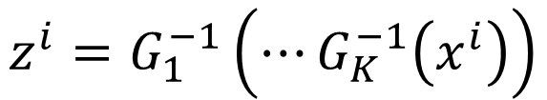

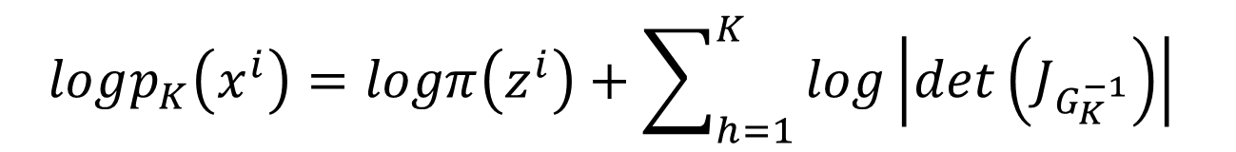

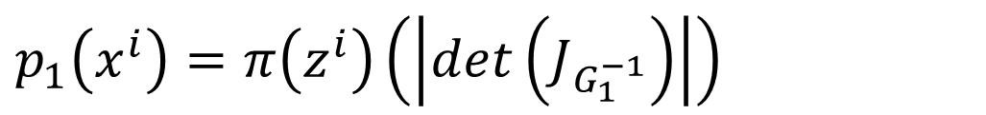
一個 G 不夠，你有加第二個嗎?
$$π\text{(}\text{x}\text{)}$$
$$p_{1}\text{(}\text{x}\text{)}$$
$$p_{2}\text{(}\text{x}\text{)}$$
$$p_{3}\text{(}\text{x}\text{)}$$
G₁
G₂
G₃
$$p_{1}\left(x^{i}\right)=π\left(z^{i}\right)\left(\left|det\left(J_{G_{1}^{−1}}\right)\right|\right)$$
$$z^{i}=G_{1}^{−1}\left(⋯G_{K}^{−1}\left(x^{i}\right)\right)$$
$$p_{2}\left(x^{i}\right)=π\left(z^{i}\right)\left(\left|det\left(J_{G_{1}^{−1}}\right)\right|\right)\left(\left|det\left(J_{G_{2}^{−1}}\right)\right|\right)$$
……
$$p_{K}\left(x^{i}\right)=π\left(z^{i}\right)\left(\left|det\left(J_{G_{1}^{−1}}\right)\right|\right)⋯\left(\left|det\left(J_{G_{K}^{−1}}\right)\right|\right)$$
$$logp_{K}\left(x^{i}\right)=logπ\left(z^{i}\right)+\sum_{h=1}^{K}{log\left|det\left(J_{G_{K}^{−1}}\right)\right|}$$
Maximize

Slide 18




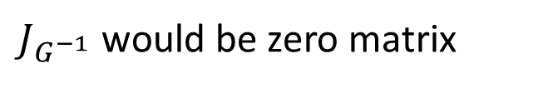


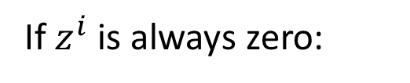

What you actually do?
G
$$z$$
$$x$$
$$logp_{G}\left(x^{i}\right)=logπ\left(G^{−1}\left(x^{i}\right)\right)+log\left|det\left(J_{G^{−1}}\right)\right|$$
-inf
Make $z^{i}$ become zero vector
If $z^{i}$ is always zero:
$J_{G^{−1}}$ would be zero matrix
$$det\left(J_{G^{−1}}\right)=0$$
$$p_{data}\left(x\right)$$
G⁻¹
$$z^{i}=G^{−1}\left(x^{i}\right)$$
$$x^{i}$$
Actually, we train G⁻¹ , but we use G for generation.

Slide 19
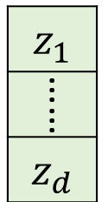
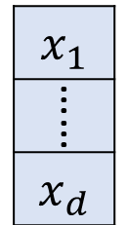
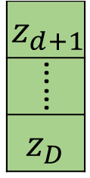
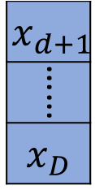








Coupling Layer
NICE
https://arxiv.org/abs/1410.8516
Real NVP
https://arxiv.org/abs/1605.08803
copy
$$i≤d$$
F
H
要多複雜都可以
$$β_{d+1}$$
$$β_{D}$$
$$γ_{d+1}$$
$$γ_{D}$$
……
……
$$x_{i>d}=β_{i }z_{i }+γ_{i }$$
$$i>d$$
$$+$$

Slide 20


Coupling Layer
NICE
https://arxiv.org/abs/1410.8516
Real NVP
https://arxiv.org/abs/1605.08803
copy
$$i≤d$$
F
H
$$z_{i≤d}=x_{i }$$
$$β_{d+1}$$
$$β_{D}$$
$$γ_{d+1}$$
$$γ_{D}$$
$$z_{i>d}=\frac{x_{i }−γ_{i }}{β_{i }}$$
……
……
$$i>d$$
$$+$$

Slide 21






Coupling Layer
F
H
$$J_{G}$$
$$det\left(J_{G}\right)$$
I
(Identity)
O
(zero)
$$=\frac{∂x_{d+1}}{∂z_{d+1}}\frac{∂x_{d+2}}{∂z_{d+2}}⋯\frac{∂x_{D}}{∂z_{D}}$$
$$=β_{d+1}β_{d+2}⋯β_{D}$$
I don’t
care.
Diagonal
$$x_{i>d}=β_{i }z_{i }+γ_{i }$$

Slide 22
Coupling Layer - Stacking
F₁
H₁
F₂
H₂
F₃
H₃
F₁
H₁
F₂
H₂
F₃
H₃

Slide 23
Coupling Layer
F₁
H₁
F₂
H₂
F₃
H₃

Slide 24




1x1 Convolution
GLOW
https://arxiv.org/abs/1807.03039
W
3 x 3
$$z$$
$$x$$
$W$ can shuffle the channels.
3
1
2
0 | 0 | 1
1 | 0 | 0
0 | 1 | 0
1
2
3
If $W$ is invertible (?), it is easy to compute $W^{−1}$.
=

Slide 25






1x1 Convolution
$$\left[\begin{aligned}x_{1} \\ x_{2} \\ x_{3}\end{aligned}\right]=\left[\begin{matrix}w_{11} & w_{12} & w_{13} \\ w_{21} & w_{22} & w_{23} \\ w_{31} & w_{32} & w_{33}\end{matrix}\right]\left[\begin{aligned}z_{1} \\ z_{2} \\ z_{3}\end{aligned}\right]$$
W
3 x 3
$$z$$
$$x$$
$$x=f\left(z\right)$$
$$=Wz$$
$$J_{f}=\left[\begin{matrix}{∂x_{1}}/{∂z_{1}} & {∂x_{1}}/{∂z_{2}} & {∂x_{1}}/{∂z_{3}} \\ {∂x_{2}}/{∂z_{1}} & {∂x_{2}}/{∂z_{2}} & {∂x_{2}}/{∂z_{3}} \\ {∂x_{3}}/{∂z_{1}} & {∂x_{3}}/{∂z_{2}} & {∂x_{3}}/{∂z_{3}}\end{matrix}\right]$$
$$=\left[\begin{matrix}w_{11} & w_{12} & w_{13} \\ w_{21} & w_{22} & w_{23} \\ w_{31} & w_{32} & w_{33}\end{matrix}\right]$$
$$=W$$
Notes:
Substep 1, 2

Slide 26




1x1 Convolution
$${\left(det\left(W\right)\right)}^{d×d}$$
If $W$ is 3x3, computing $det\left(W\right)$ is easy.
…………
W
0
$$d×d$$
positions
W
……
……
0
W

Slide 27









Demo of OpenAI
Source of image:
https://hd.stheadline.com/life/ent/realtime/1517562/
$$G^{−1}$$
$$z_{1}$$
$$G$$
$${0.5z}_{1}+{0.5z}_{2}$$
$$G^{−1}$$
$$z_{2}$$

Slide 28














Demo of OpenAI
如何讓人笑起來
$$z_{smile}$$
$$z$$
$${z+z}_{smile}$$
$$G^{−1}$$
$$G$$

Slide 29
Demo of OpenAI
https://openai.com/blog/glow/

Slide 30


To Learn More ……
Parallel WaveNet
WaveGlow
https://arxiv.org/abs/1711.10433
https://arxiv.org/abs/1811.00002

